Slide 1
Data Mining
By Dharma Pradhan
MCA 1st Year
Data Mining: Concepts and Techniques

Slide 2


Slide 3

Data mining
Data mining refers to extracting knowledge from large amounts of data.
Similar to “gold mining”.
There are some other term related to data mining such as “knowledge discovering”, “knowledge extraction” etc.

Slide 4
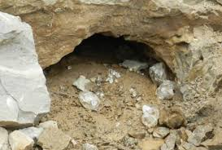
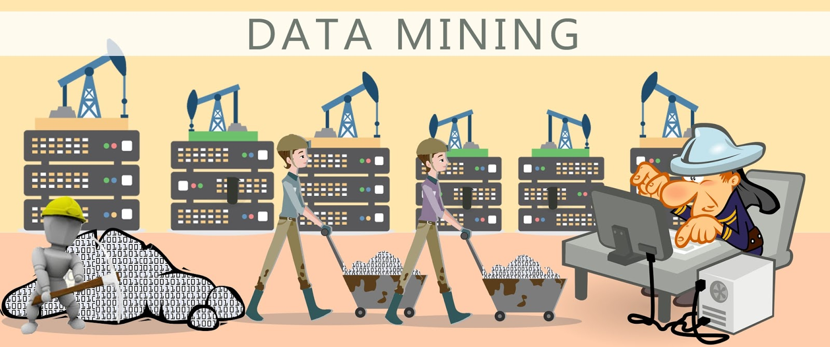
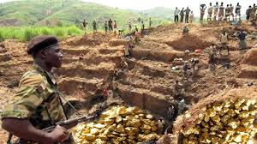
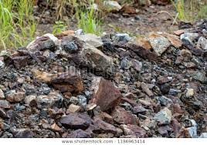
Gold & Diamond
Mining

Slide 5
Data mining
It is the computational process of discovering patterns in large data sets (big data ) involving methods at the intersection of artificial intellegece, machine learning , statistics and data base systems .
The overall goal of the data mining process is to extract information from a data set and transform it into an understandable structure for fresher use.
Data mining is the analysis step of the “knowledge discovery in data bases” process or KDD.

Slide 6
What is( not) data mining
What is not data mining ?
Look up phone no in phone directory.
Query a web search engine for information about “something”.
What is data mining ?
Certain names are more prevalent in certain indian location(orissa,india) .
Group together similar document returned by search engine according to their context (eg. Amazon.com)

Slide 7
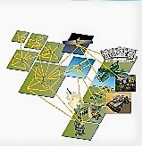

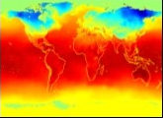

Why mine data ? Scientific view point
Data collected and stored at enormous speeds (GB/h).
Remote sensors on a satellite
Telescope scanning the skies
Microarrays generating gene expression data
Scientific simulations generating terabytes of data
Traditional techniques infeasible for raw data
Data mining may help scientists
in classifying and segmenting data
in Hypothesis Formation

Slide 8
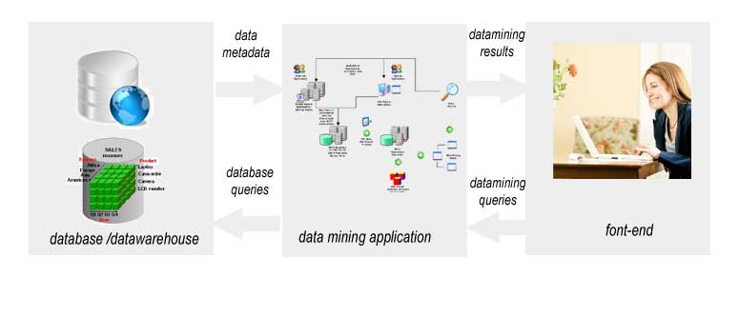
Data Mining Architecture

Slide 9
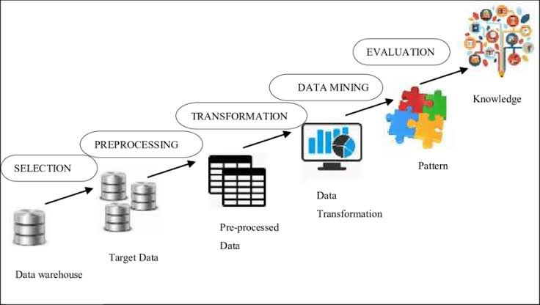
Data Mining Process

Slide 10
Uses Of Data Mining
AI/Machine Learning
Combinatorial/Game Data Mining
Business Strategies
Identify customer demographics, Preferences and purchasing patterns.
Extra-Terrestrial Intelligence
Scanning Satellite receptions for possible transmissions from other planets.
Health and Science
Risk Analysis

Slide 11
Advantages of Data Mining
Marketing/ Retail
Finance/ Banking
Manufacturing
Governments

Slide 12
Conclusion
Comprehensive data warehouses that integrate operational data with customer, supplier and market information have resulted in an explosion of information.
Competition requires timely and sophisticated analysis on an integrated view of the data.
However there is a growing gap between more powerfull storage and retrieval systems and the user’s to effectively analyze and on the information they contain.

Slide 13
THANKS

